Slide 1
HOW ASSESSMENTS MOVED ONLINE AT SGUL
Dr Izzie Mark (Psychiatry SpR, Clinical Teaching Fellow and Lecturer)
Marina Pearson (P-Year medical student, Group A)
Achvini Sriskanthanathan (P-Year medical student, Group B)

Slide 2
OUTLINE OF SESSION
Assessment primary aims and approach
Presenting:
SGUL Assessments BEFORE COVID-19
SGUL Assessments AFTER COVID-19
Reflections and Evaluation (both educator and student perspectives)

Slide 3
ASSESSMENT AIMS & APPROACH
Primary aim of assessments should be for learning (1, 2).
Formative assessments have been considered to have better potential for learning, with summative better for assessment of learning (3).
The process of giving feedback to students (through assessment) is crucial in influencing learning and subsequent achievements (4).
Feedback should be:
detailed, constructive, timely, received and attended to (1).

Slide 4
WHAT TO ASSESS?
Content should be constructively aligned to course learning objectives and teaching activity (5, 6).
Assessing and developing threshold concepts is a potential focus:
Critical difficult skills and knowledge that students need to learn
Transformative, troublesome, bounded, irreversible, integrative
In Psychiatry, threshold concepts identified are:
Therapeutic risk taking
Understanding diagnostic uncertainty
Biopsychosocial model (7)

Slide 5
BEFORE COVID-19
Psychiatry Placements in P-Year
DURING PLACEMENT
WORK BASED ASSESSMENTS- Compulsory but Formative – to track progress and inform learning
2X Mini-CEXs
2X Case-Based Discussions (CBD)
Long Case Write up- Compulsory but formative
In addition:
Group teaching via Clinical Problem Based Learning (CPBL) discussion groups
Weekly supervisor meetings to informally gauge knowledge and provide direction
AFTER PLACEMENT/END OF YEAR
Summative- To measure competence, if ready to progress, discriminate between students
Written exam (single best answer questions)
Objective Structure Clinical Examination (OSCES)

Slide 6
AFTER COVID-19
Psychiatry Placements in P-Year
DURING PLACEMENT
Aiming to match work-based assessments: optional/ formative
Buddy work: role-play (OSCE) session (facetime)
Buddy work: presentation session
(both with structured feedback guide)
Long Case Write up- optional/ formative
In addition:
Small-group teaching via Case Problem Based Learning (CPBL) discussion on MS Teams
Additional ‘pub quiz’ session on MS Teams
AFTER PLACEMENT/END OF YEAR
Summative- To measure competence, if ready to progress, discriminate between students
Written exam (single best answer questions)
Objective Structure Clinical Examination (OSCES)

Slide 7
DURING PLACEMENT
Aiming to match work-based assessments: optional/ formative
Buddy work: role-play (OSCE) session
Buddy work: presentation session
(both with structured feedback guide)
Long Case Write up- optional/ formative
In addition:
Group teaching via Case Problem Based Learning (CPBL) discussion groups
Additional ‘pub quiz’ session
Using peers as assessors
Video cases- 1 of 3, standardised cases for easy marking
Templates, model answers, other letter examples , clear criteria
transparency, constructive alignment
Students to gauge their own learning based on answers and scores- will depend on engagement/ motivation
Helps continue focus for written exam
Aiming to continue opportunities for students to receive feedback which can be: detailed, constructive, timely, received and attended to (1), to encourage student self-regulation, motivation, improvement.
Aiming to still cover threshold concepts, key for transformative learning (7)

Slide 8
BUDDY WORK

Slide 9
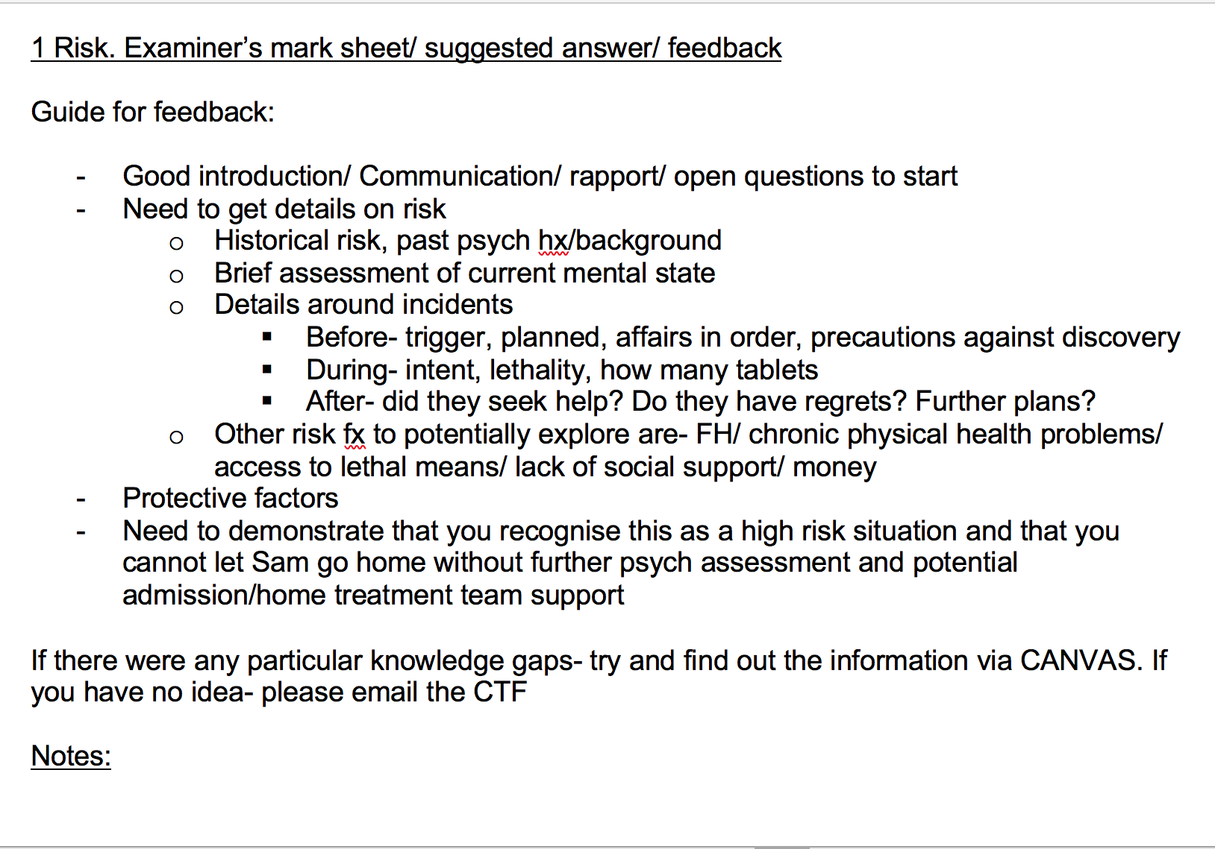
BUDDY WORK

Slide 10
LONG CASE WRITE UP

Slide 11
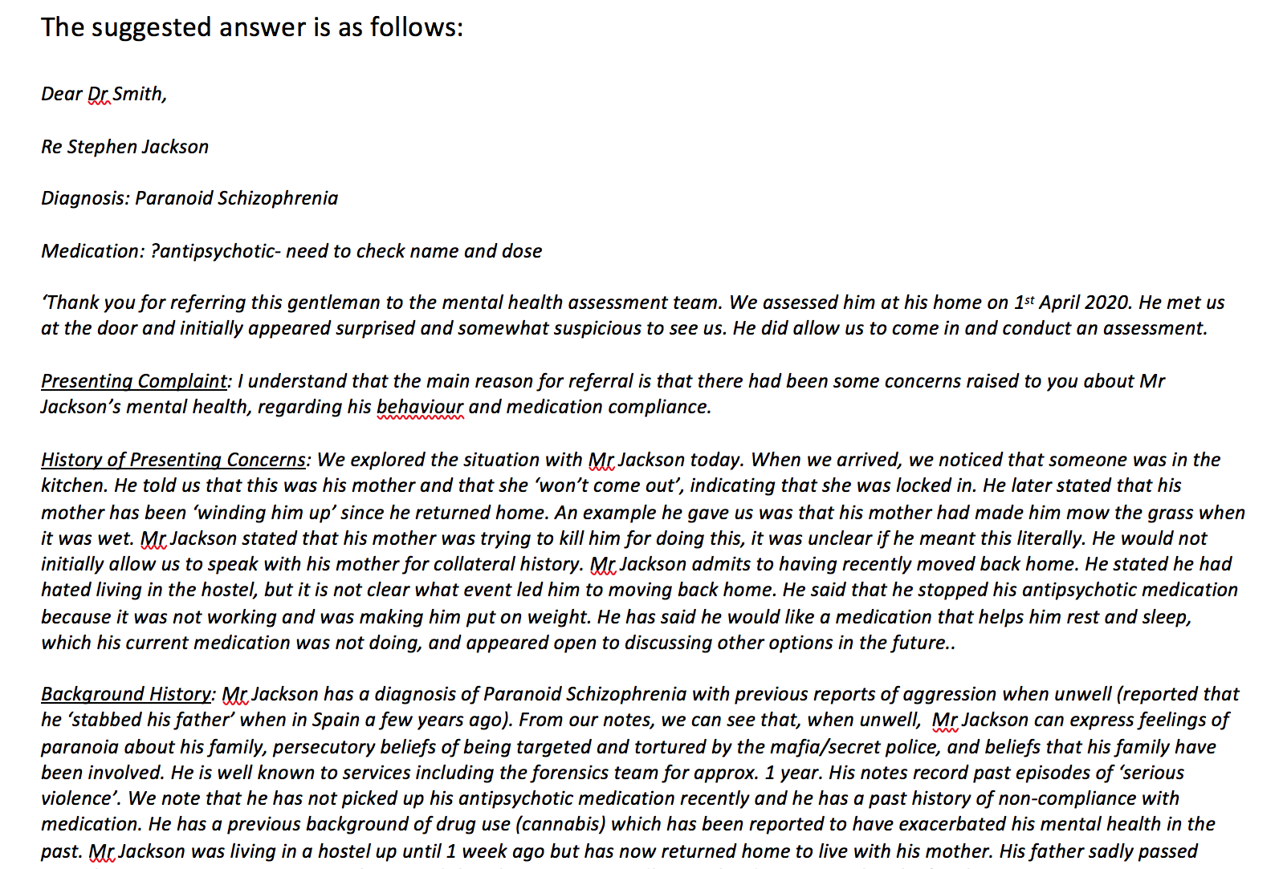
LONG CASE WRITE UP

Slide 12
GROUP ‘PUB’ QUIZ

Slide 13
GROUP ‘PUB’ QUIZ

Slide 14
Educator reflections:
Positives
Quick to set up
Using the resources available
Resources and reference material
Not dependant on ‘teacher time’
Continuing to monitor student progress and give feedback
Creative
Flexible
Optional
Variety
‘Fun’
Limitations
Limited time to plan
No previous technology experience
Limited ‘teacher-time’
Mixed engagement from students
Varied personal challenges
Some students less confident about assessing each other
Videos/role-plays: not substitute for clinical contact

Slide 15
Educator improvement ideas:
Pros and cons with students as peer assessors-> ? switch buddy work to small group teaching with tutors facilitating (teacher-time dependent)
Consider expert patients instead of role plays (resource dependent)
Create more video options for case-write up (time-dependant)
More clarification on optional/formative/summative expectations (Covid dependant)
We are still quickly learning…
Other options (group chat?!)

Slide 16
Student perspectives
Marina
Group A: 3 weeks.
Pub quiz: useful in identifying areas requiring more revision.
Idea for improvement: could introduce a pharmacology quiz – high yield topic.
Buddy work: Mock OSCE station was good to practice comm skills and get written feedback from CTF answering specific queries.
Idea for improvement: provide one CTF moderated station to help spot weaker areas and ensure we can carry out a safe risk assessment.
Achvini
Group B: 5 weeks
Buddy work: Presentations were a good way to go over core knowledge.
Improvement ideas: Incorporate this into a small group session so we could cover more topics and get feedback/ questioned answered by a CTF.
Written task: useful way of working through how to take a psychiatric history.
Improvement ideas: Include a section to list further questions we may want to ask following on from the interview video before moving forward with a management plan.

Slide 17
Conclusions
Assessment and feedback to students a priority for learning
In responding to Covid-19 restrictions: creativity, flexibility and quick-thinking was required
Maintaining an open mind
Importance of reflection and responding to student evaluation
Collaboration benefits
Thank you ☺

Slide 18
References
1. Gibbs G and Simpson C (2005) Conditions Under Which Assessment Supports Students’ Learning. Learning and Teaching in Higher Education (1). pp. 331.
2. Price M, Carroll J, O’Donovan B & Rust C (2011) If I was going there I wouldn’t start from here: a critical commentary on current assessment practice, Assessment & Evaluation in Higher Education, 36:4, 479-492
3. Bennett RE (2011) Formative assessment: a critical review, Assessment in Education: Principles, Policy & Practice, 18:1, 5-25
4. Hattie J, Timperley H (2007) The Power of Feedback. Review of Educational Research March 2007, Vol. 77, No. 1, pp. 81-112
5. Quality Assurance Agency (QAA) (2018) UK QUALITY CODE, ADVICE AND GUIDANCE: ASSESSMENT. https://www.qaa.ac.uk/en/quality-code/advice-and-guidance/assessment#
6. Biggs JB (2005). Aligning teaching for constructing learning. The Higher Education Academy Retrieved 17 June 2020,
7. Khatri R, Knight J, Wilkinson I (2020) Threshold concepts: A portal into new ways of thinking and practising in psychiatry, Medical Teacher, 42:2, 178-186

